Slide 1

Big Data and Hadoop
Software is eating the world. Data is the new oil.
Casey Bain
Dec 2017

Slide 2
Software is eating the world.
Data is the new oil.
Notes:
While it might sound a little cliche, I adamantly believe both of these statements.
Why i chose big data as my topic today….
My entire career to date has been closely aligned to data driven systems or databases. Trying to get business value out of those systems. Asking business questions against those systems. Distilling the signal from the noise to make better decisions, gain insights and enhance competitive intelligence.
P&G – US Market Analysis reporting tools
HP – P&G Leading QTR Financial Reporting and IP BIS
Nordstrom – Real-time serving of Credit Warehouse Data to drive customer loyalty and sales
dunnhumby & 84.51 – nearly everything we did was to support collection, processing to enable our customer data science and surfacing through software and targeted marketing vehicles
Software was said by Marc Andresssen – Founder: Netscape & VC firm, Board member: Facebook, Hewlett Packard Enterprise, Oculus VR)
Things that needed people can now be done entirely in software
Eg. Priceline and Expedia ate travel agents. And, Uber is eating taxis, and AirBnB is eating hotels.
Data credited to be said by Clive Humby – Founder: dunnhumby

Slide 3
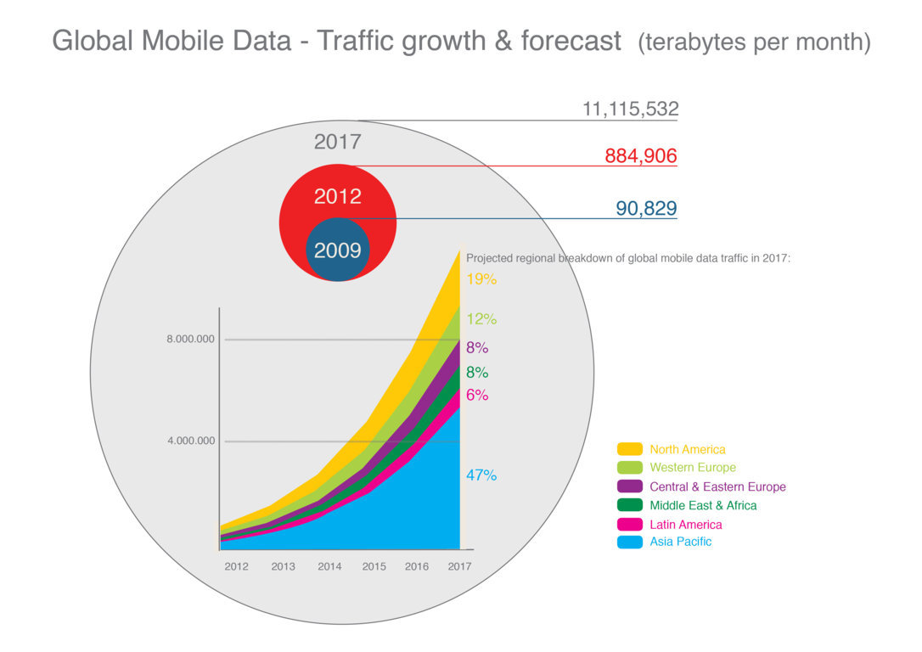
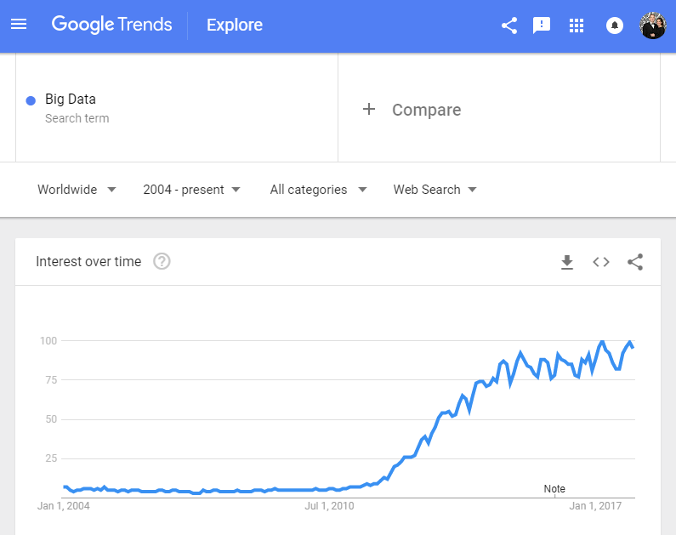
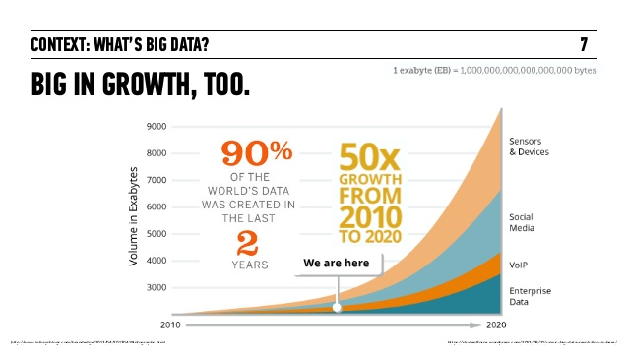
Notes:
Image on the left: Google Trends for Big Data searches.
It reminds me of the quote….
Big data is like teenage sex: everyone talks about it, nobody really knows how to do it, everyone thinks everyone else is doing it, so everyone claims they are doing it
So why is everyone talking about it….
2 of the primary paradigm shifts technology have led to the explosion of data and the need for the nebulous term Big Data
– the internet (connecting computers…and more importantly people, globally)
- mobile phones (6 of the ~7 billion people on the planet now have mobile phones – many of those phones are more powerful than the most powerful supercomputer just 30 years ago – (Cray-2 Supercomputer))
The graphics on the right give you a feel for the emergence of both of those technologies and their meteoric rise in production of data.
In fact, it’s been estimated that from the dawn of civilization to 2003 about 5 Exabytes of information was created. –Eric Schmidt, Google
We are now producing that amount of data every 2 days. That’s a crazy amount of crazy that pace is accelerating.
So we’ve got a new nebulous new term, everyone is talking about it, everyone if participating in creating the new paradigm shift….. so the market explodes

Slide 4
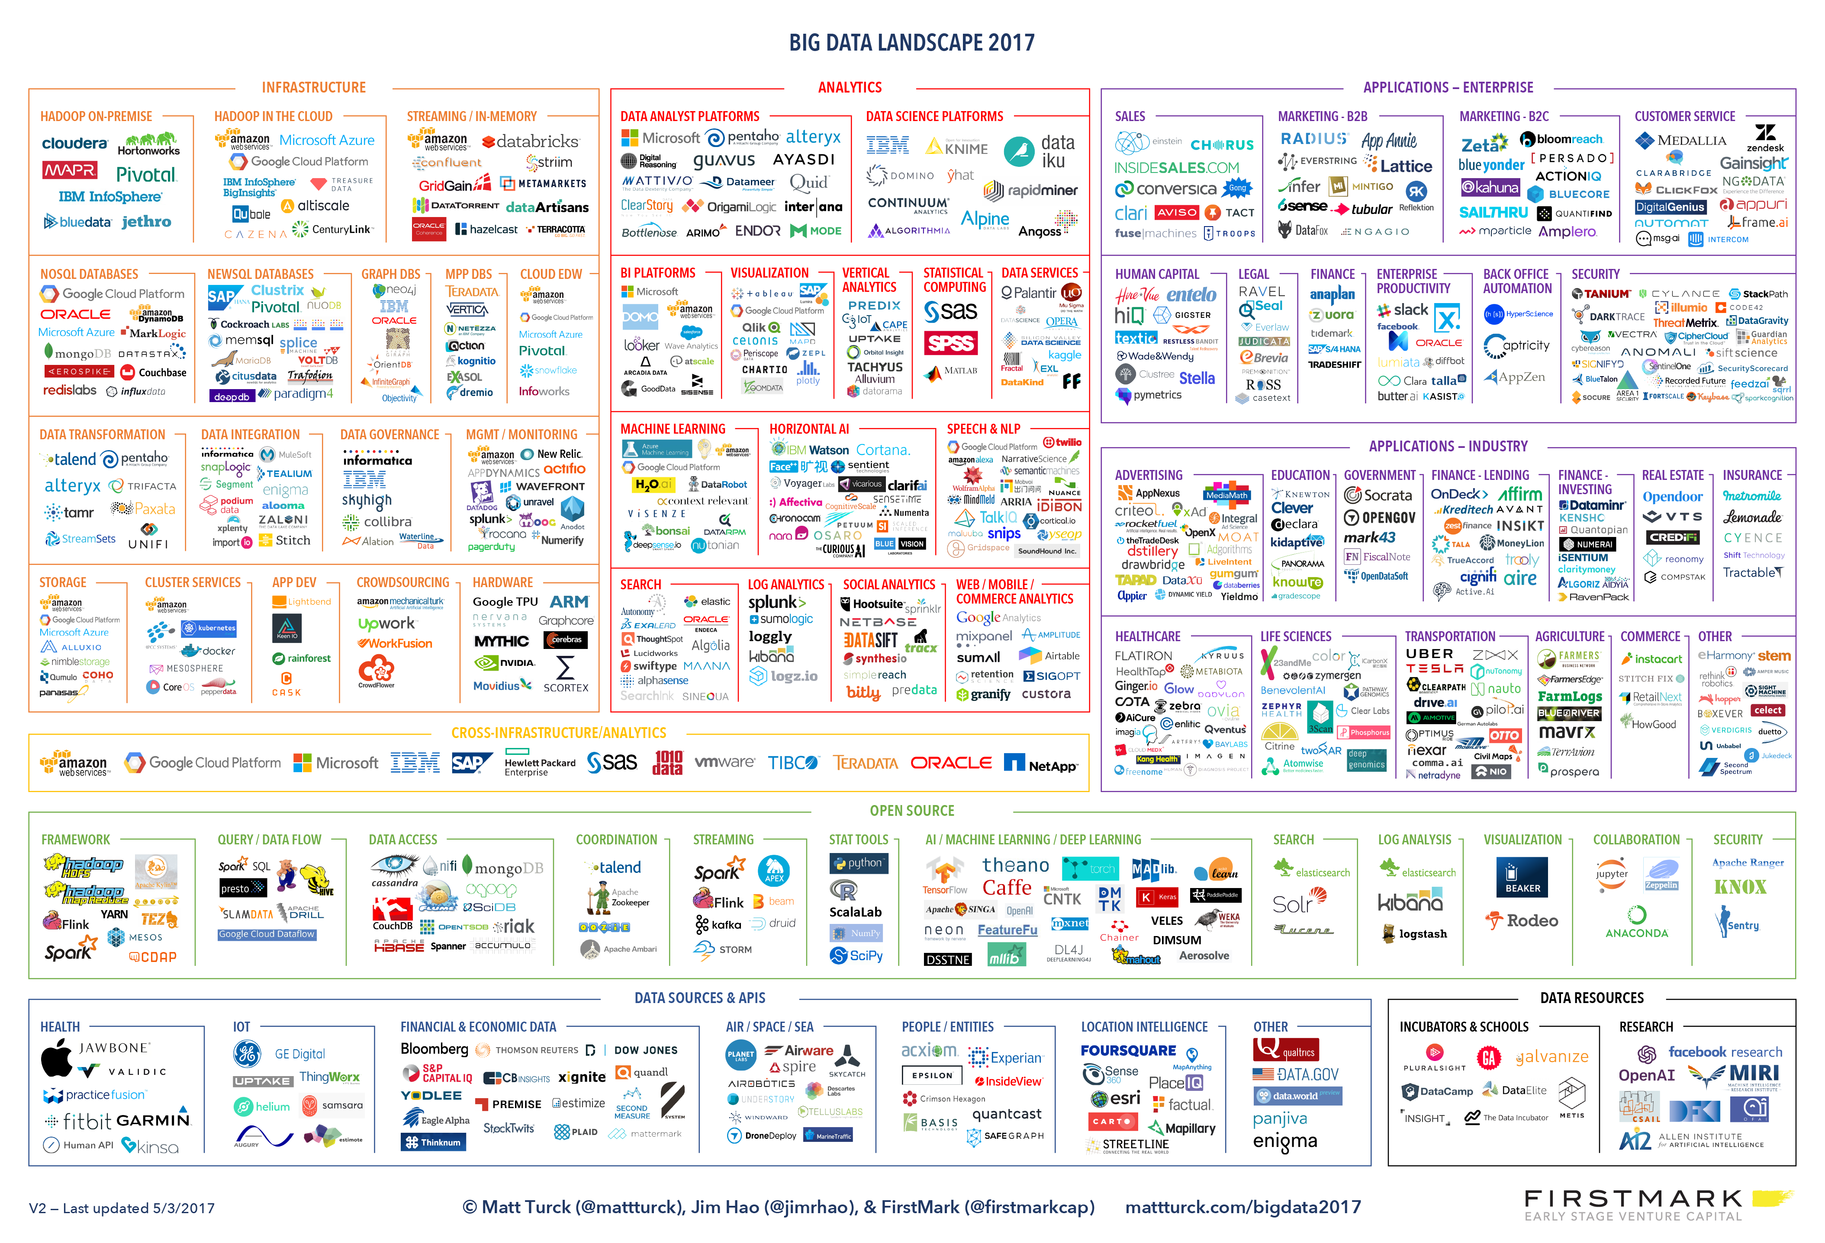
Notes:
It’s estimated that the current market size of Big Data in 2017 is

Slide 5
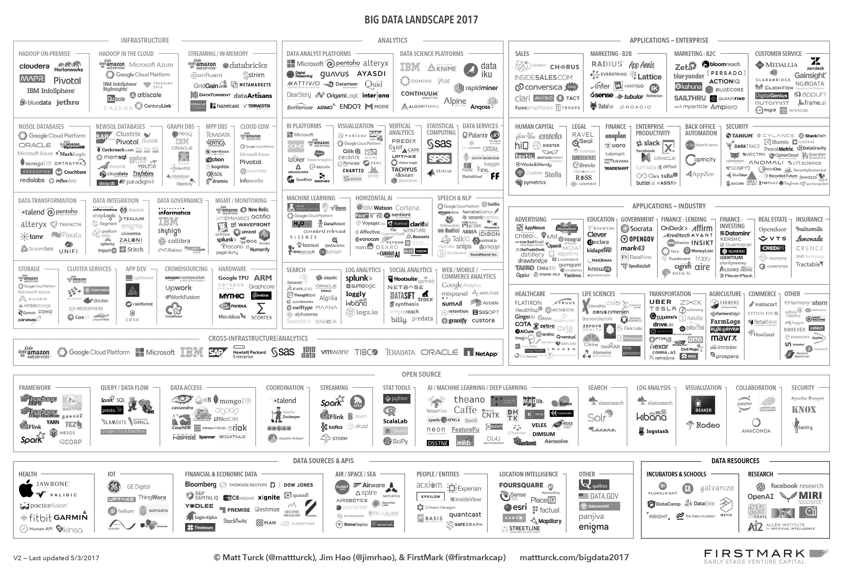
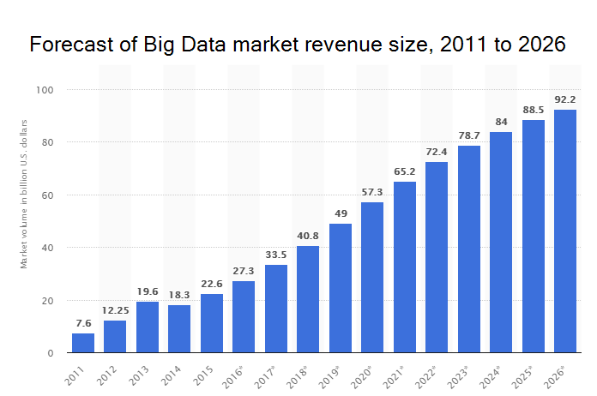
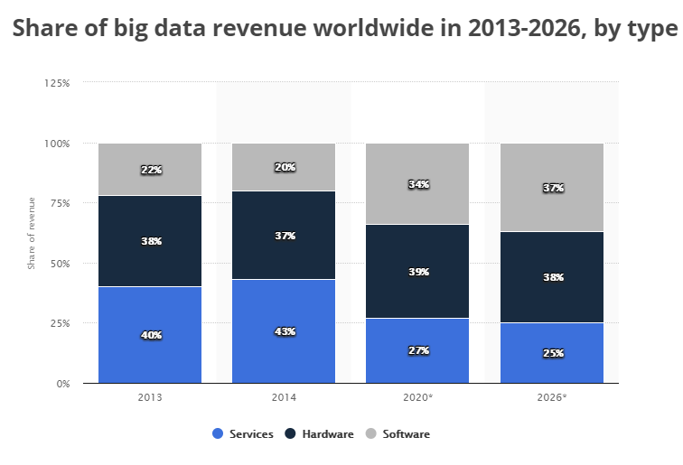
Notes:
It’s estimated that the current market size of Big Data in 2017 is $33.5 billion US (or ~2.3 million bitcoin)
The conservative forecast is to surpass $100 Billion in less than a decade
The revenue split by type has been 80% hardware services but software revenue is forecast to double, mostly sourced from services
As the software gets better, the need to have professional services lessens.

Slide 6
So what is Big Data?
Notes:
So everyone is talking about it.
Everyone is participating in it’s creation.
The market is exploding.
And there’s billions to be made.
So what is it again?

Slide 7
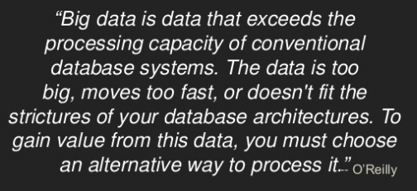
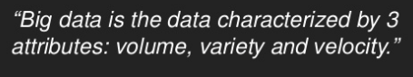
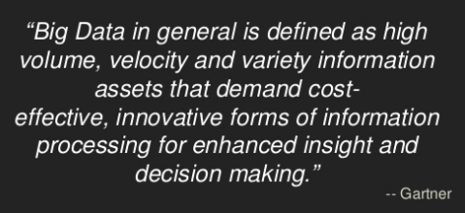
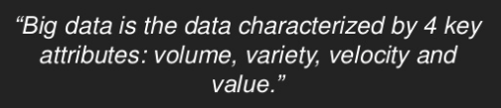
So what is Big Data?
Notes:
Ask 10 people what big data is and you’ll likely get 10 different answers…but with themes and commonalities.
Let’s take a look at a few of the more popular definitions.
#1 – 3Vs: Volume, Variety and Velocity
#2 - #1 + cost pressures and need for something new
#3 – sounds a lot like 2 but scores higher in buzzword bingo.
#4 – 4 Vs: Volume, Variety, Velocity and Value/Veracity

Slide 8
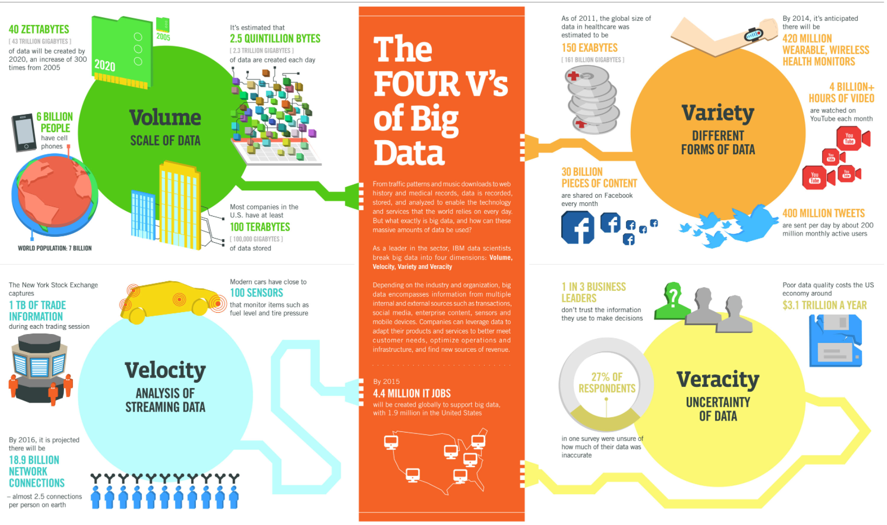
Notes:
Instead of be confined to a single comprehensive definition, let’s talk about the 4 dimensions of big data we heard from those definitions

Slide 9
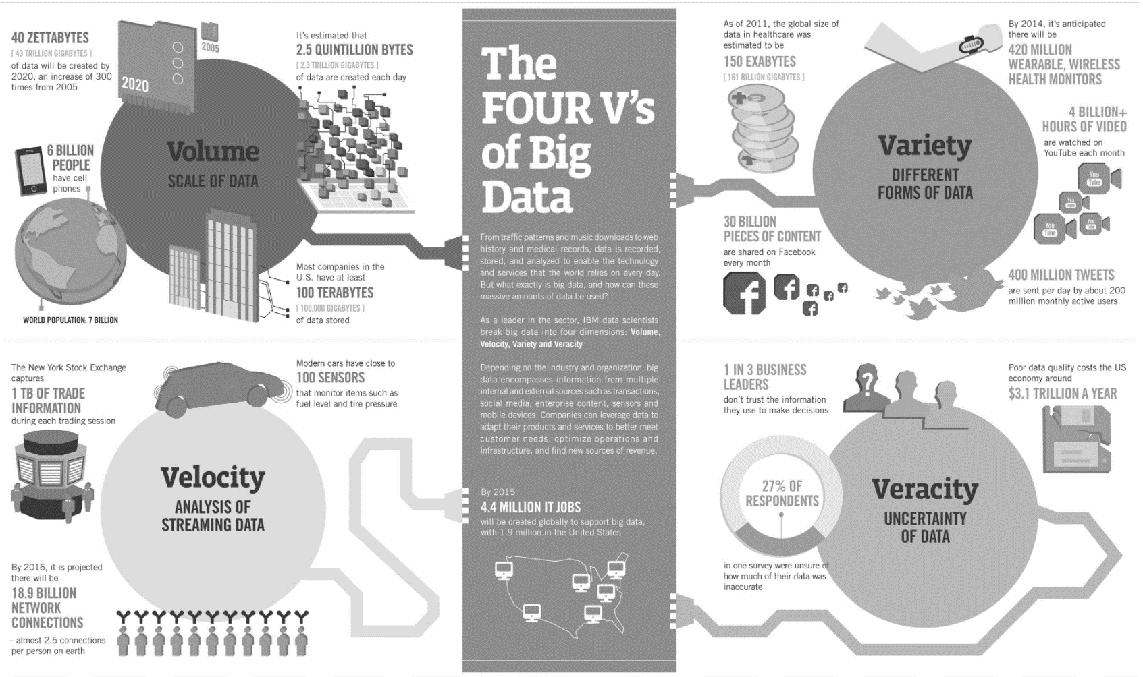
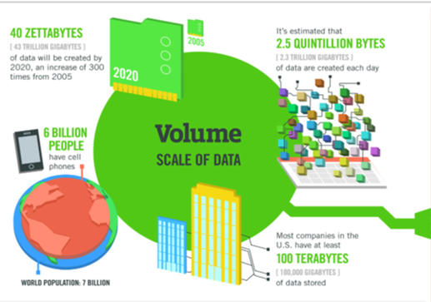
Notes:
Volume – 40 Zettabytes by 2020. 300x increase from 2005.
2.5 Quintillion bytes created every day
2.7 Zetabytes of data exist in the digital universe today – 2.7M terabytes.

Slide 10
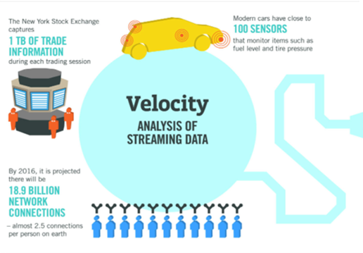
Notes:
Velocity – 1 TB data in 6.5 hours of NYSE trading…not to mention all the other markets
2.5 network connections per person on earth….as of last year

Slide 11
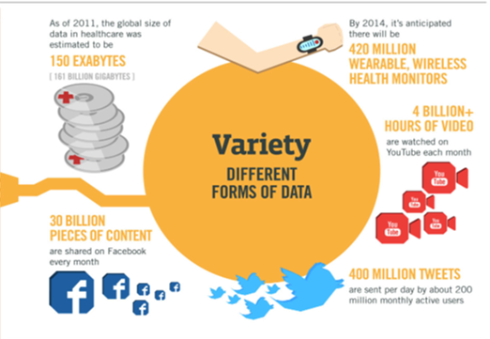
Notes:
Variety- User created data like twitter and facebook, video consumption data like youtube and netflix, IoT/sensor data, machine logs

Slide 12
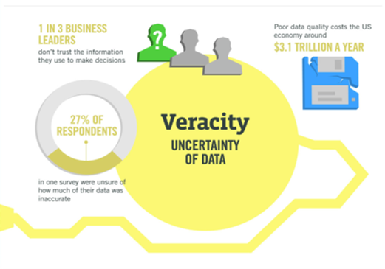
Notes:
Veracity- I’ll use this one interchangeably with value. Can I trust it? What is the quality of the data? Do I get any value from this data?

Slide 13
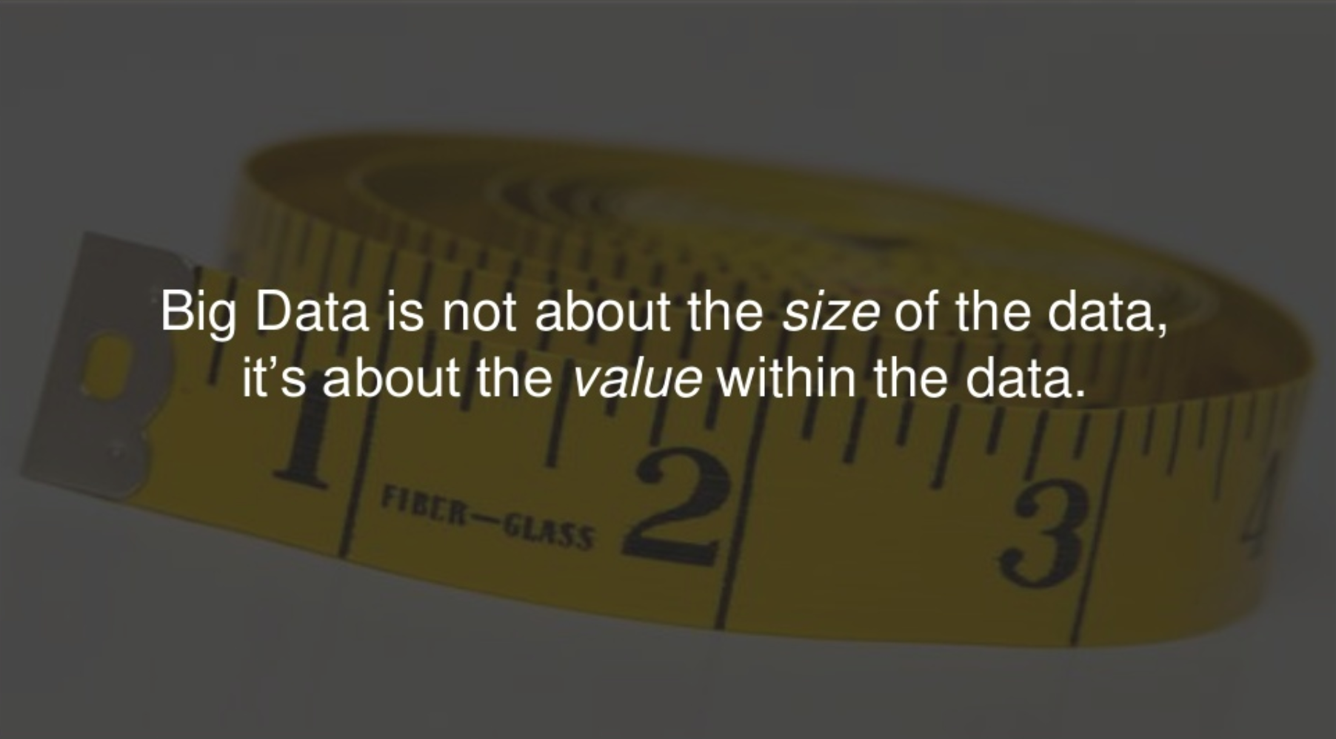
Notes:
It’s that last point that I feel is most important…..what is the value of the data?
Data is the new oil…..but only if you can refine it.
Crude oil doesn’t have any tangible uses in it’s raw form. It has to be turned into things like gasoline, diesel, plastics, asphalt to be useable and valuable.
Much like crude oil….data for data’s sake doesn’t have much value. Until you refine, distill, process and transform it you don’t get much from it.

Slide 14

Notes:
Only those that understand how to separate the signal from the noise and get value our the tsunami of data will be successful

Slide 15
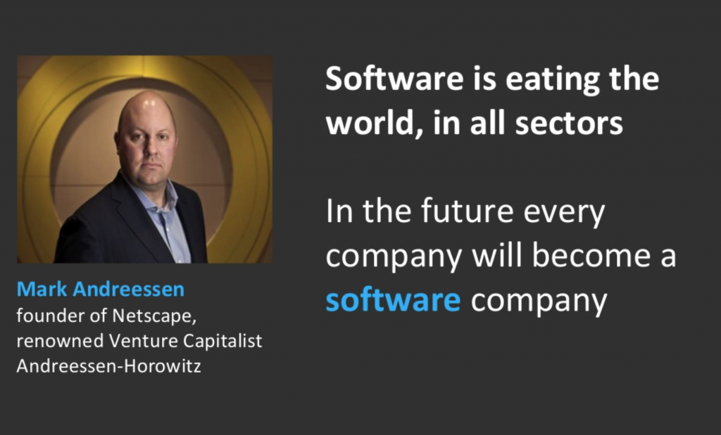
Notes:
I don’t pretend to know what the looks like in future but I do believe it.
That said, given the challenges of BIG DATA, I do know of a collection of software projects and frameworks that is driving nearly every company that wants mine their data value in hopes of finding insights and competitive advantage.

Slide 16
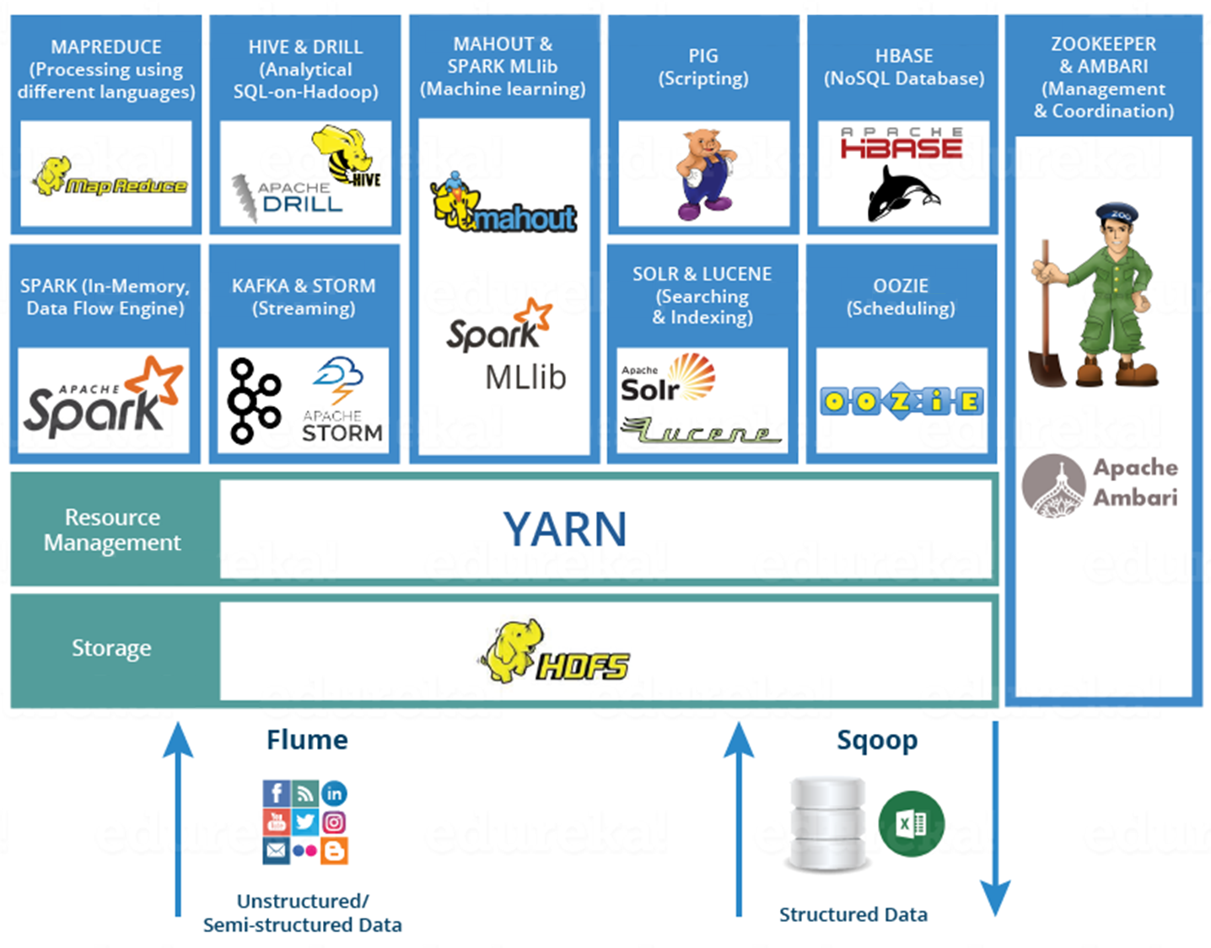
Notes:
Not comprehensive but had the best collection of the various projects I wanted to discuss today.
I’ll touch on the some of the high level that I’ve had some experience with in the last few years at dunnhumby, 84.51

Slide 17

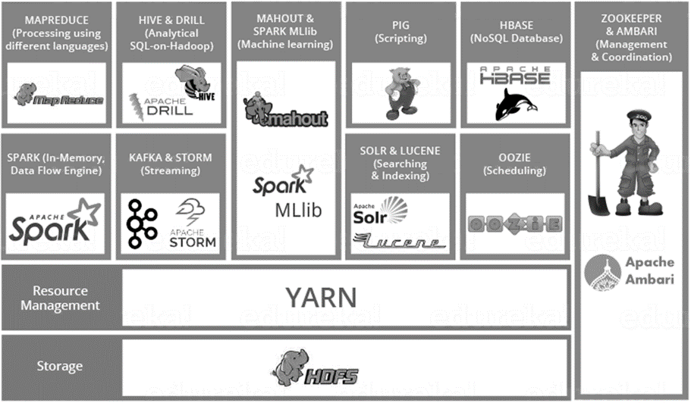
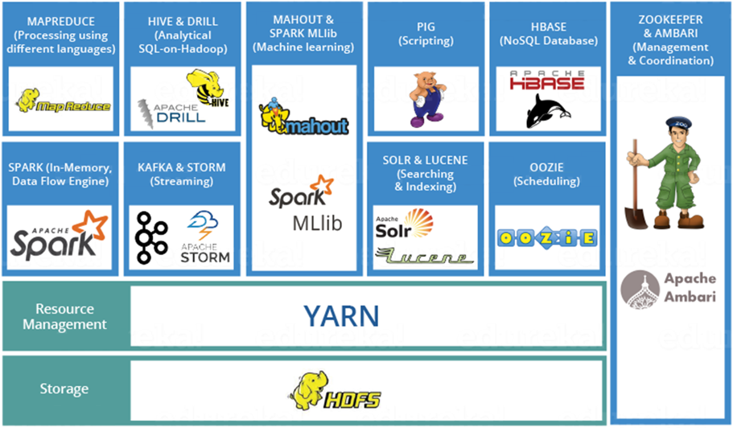


Hadoop Distributed File System
Java based file system that provides scalable and reliable data storage for large volumes of data
designed to span large clusters of commodity servers
scalable, fault-tolerant, distributed storage system that works closely with a wide variety of concurrent data access applications, coordinated by YARN
Yet Another Resource Negotiator
Framework that facilitates writing distributed processing frameworks and applications
Coordinates a wide variety of concurrent data access applications
ResourceManager: keeps track of live nodes and the available resources
ApplicationMaster: coordinates the execution of all tasks within its application & asks for resource containers to run tasks
NodeManager: takes care of the individual compute nodes in a Hadoop cluster
HDFS & YARN together form the data management layer of Apache Hadoop
Notes:
Previously we were inbounding Kroger transactional data as flat files and storing them in Isilon and weekly batch loading them in SAS (Dimensions) & SAND (Facts) then using home grown tools to publish into Oracle Exadata.
For 2+ years we’ve been SLOWLY, performing a tech stack refresh and moving away from a the legacy system into to Hadoop

Slide 18


HIVE is a data warehouse software project built on top of Hadoop.
Designed for OLAP
de facto standard for SQL like queries in Hadoop
Provides the ability to project structures on to data much like relational databases
Stores schema in database and processed data on HDFS
To accelerate queries, it provides indexing
Familiar, fast and scalable

Slide 19

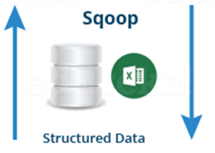

Oozie is a Java Web application used to schedule Hadoop jobs
Notes:
For the last 2 years we have heavily used oozie and sqoop as part of replacing the ETL we had in SAS DI feeding the Oracle Exadata enterprise warehouse
Oozie allowed us to build workflows with
Sqoop has allowed us to source some data from Exadata (segmentations only created in Oracle and not migrated to Hadoop) as well as duel publish to the SOURCE (warehouse) area of HDFS and Exadata

Slide 20


Spark is a general-purpose data processing engine
In memory so VERY fast
Performs generalized form of map-reduce to split processes across large number of nodes
Fast enough for interactive analysis
Resilient Distributed Datasets and Dataframe tabular structures
Spark SQL!
Spark SQL is a Spark module for working with structured data
Familiar way to work with data for those coming from the relational world
Many operations can easily and efficiently be expressed in SQL (filters, joins, group by, aggs)
Can leverage Hive metastores
Notes:
This is the area we’ve been POCing to move from hive for ETL and customer segmentation creation

Slide 23


